Slide 1
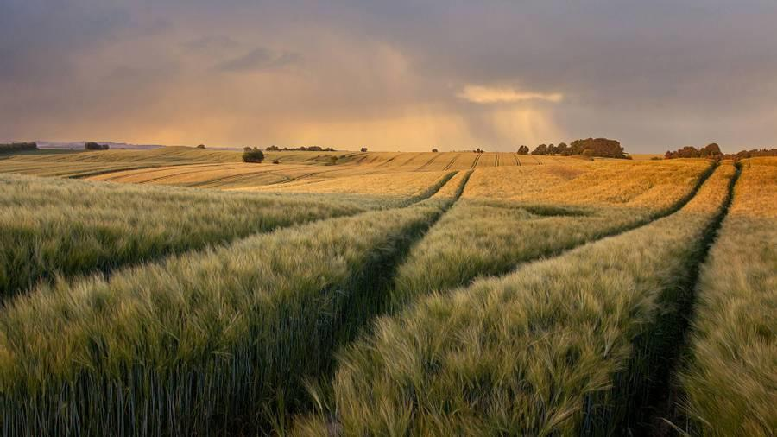
Crop Recommendation System Muhammad Arslan Shaukat Ali Ahmed raza

Slide 2

Objectives:
Develop machine learning model for crop recommendations.
Enable informed decisions to enhance agricultural productivity.
Promote sustainable agriculture.

Slide 3
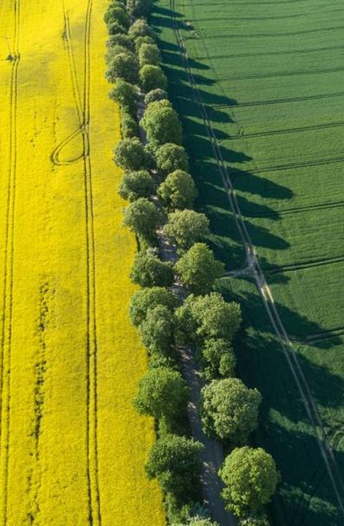
Problem Statement
Challenge of traditional methods in Pakistani agriculture.
Lack of data-driven solutions for optimal crop selection.
solution
Overview
Benefits
Precision Agriculture Crop Recommendation System.
Machine learning for informed crop selection using specific datasets.
Enhanced Crop Yield.
Resource Optimization.
Cost Reduction.
Informed Decision-Making.
Sustainable Agriculture.

Slide 4

Methodology & Data Collection
Methodology
Data collection, preprocessing, and model development.
User interface development for accessibility.​
Data Collection
N (Nitrogen content in soil)
P (Phosphorous content in soil)
K (Potassium content in soil)
Temperature (in degrees Celsius)
Humidity (in %)
pH value of the soil
Rainfall (in mm)
​

Slide 5
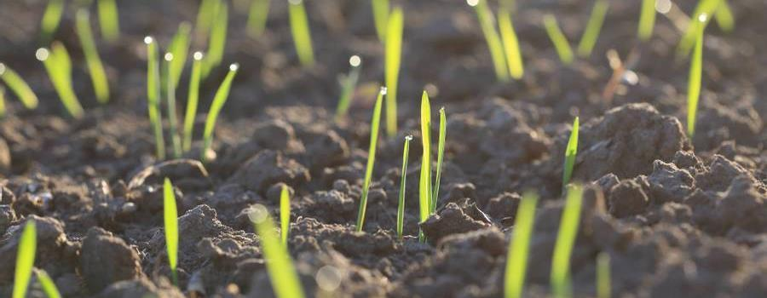
Implementation
Implementation
Python, scikit-learn, TensorFlow or PyTorch for ML.
PERN stack for web development, PostgreSQL for data storage.
Soil Moisture Sensors to collect data from field

Slide 6
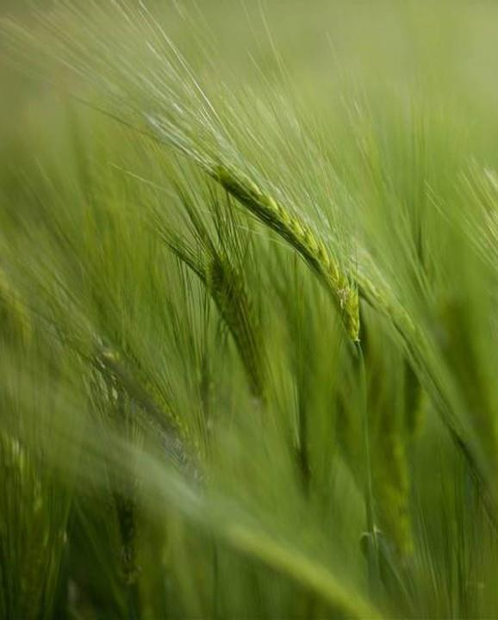
Timeline
How we’ll scale in the future​
Task | Start Date | End Date | Duration
Project Initiation | 11/01/2023 | 11/03/2023 | 3 days
Data Collection | 11/04/2023 | 11/14/2023 | 11 days
Data Preprocessing | 11/15/2023 | 11/24/2023 | 10 days
Machine Learning Model Development | 11/25/2023 | 12/10/2023 | 16 days
User Interface Development | 12/11/2023 | 12/28/2023 | 18 days
Testing and Validation | 12/29/2023 | 01/08/2024 | 11 days
Documentation and Final Report | 01/09/2024 | 01/13/2024 | 5 days
Project Conclusion | 01/14/2024 | 01/15/2024 | 2 days

Slide 7

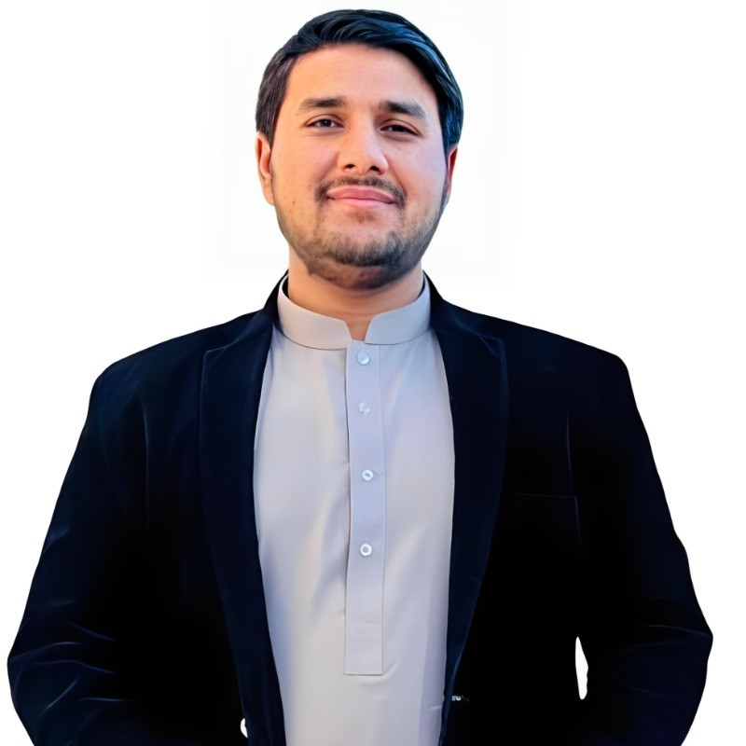
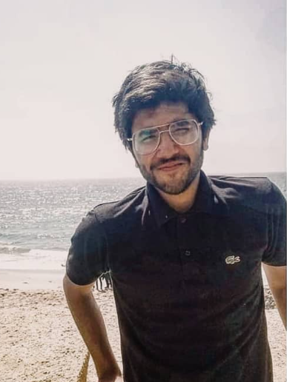
Meet the team
ARSLAN
Senior Engineer​​
Ali
Engineer​​

Slide 8

summary
This project aims to enhance precision agriculture by providing a robust Crop Recommendation System tailored to the specific needs of farmers in Pakistan. It is an opportunity to promote sustainable farming practices and increase agricultural productivity.

Slide 9
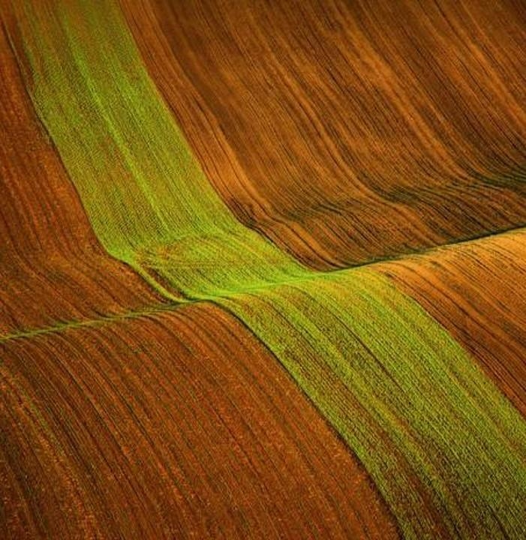
Thank you
Arslan Shaukat
01-134211-053
Ali Ahmed Raza
01-134211-115

